Slide 1
Team 4 Final Project
Brandon Gathright
Joseph Muir
Yukon Peng

Slide 2
Defense

Slide 3
Motivation

Slide 4
Solution

Slide 5
Start deeper explanation w/ screenshots here

Slide 6
Attack

Slide 7
Motivation
Develop a novel method of generating adversarial samples that bypass ML-based static antiviruses from other teams.
Must take any Windows virus and modify it to evade detection
Must retain functionality.

Slide 8
Solution
Comparing all papers covering in this class, Dr. Botacin’s method proved to yield the highest evasion rates.
We decided to take the existing example on Github and augment it with improvements.

Slide 9
Baseline Attack
Combined Dr. Botacin’s filesystem.exe and inmemory.dll droppers into a single dropper that:
Compiled into an executable
Contained a single resource
XOR decrypted the resource
Base64 decoded the resource
Wrote the resource to file
Launched the resource
Dynamically loaded 90% of APIs
Encoded strings as int arrays
Mimicked the NTDLL.dll

Slide 10
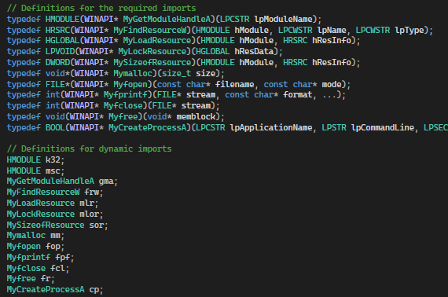
Baseline Attack Visualization
Dynamic APIs from inmemory.dll

Slide 11
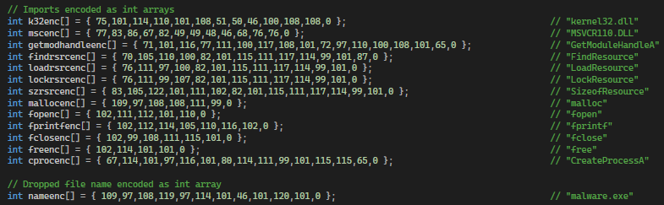
Baseline Attack Visualization
Encoded API strings from inmemory.dll

Slide 12
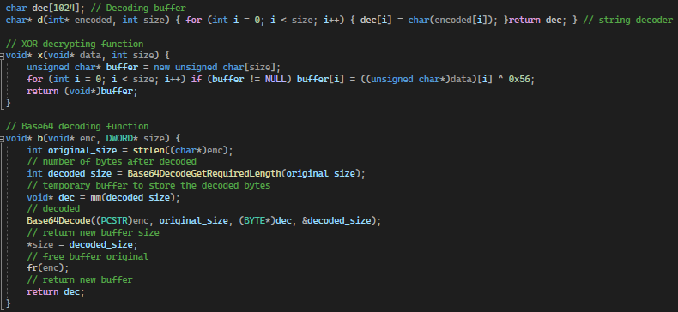
Baseline Attack Visualization
Int array decoder, XOR decrypter, and Base64 decoder from filesystem.exe

Slide 13
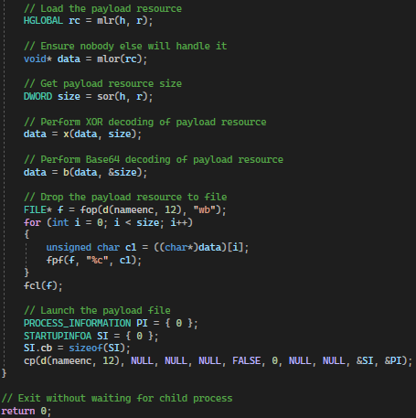
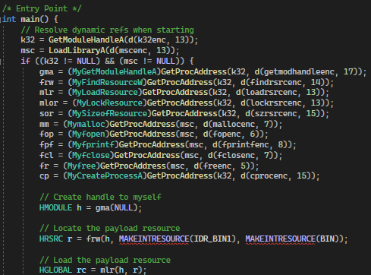
Baseline Attack Visualization
Main program combined from filesystem.exe and inmemory.dll

Slide 14
Attack v1 Summary
A list of improvements added:
Removed all remaining but 3 static APIs from original attack
GetModuleHandleA
GetProcAddress
LoadLibraryA
Replaced original handle reference to Kernel32.dll
Further encrypted the int arrays by applying ROT1
Implemented manual Base64 decoding

Slide 15
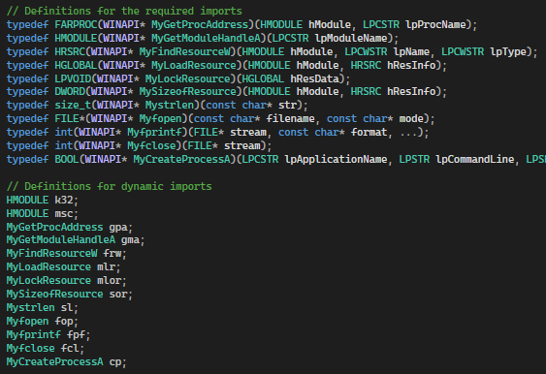
Attack v1 Visualization
Added dynamic APIs for:
GetProcAddress
Strlen

Slide 16
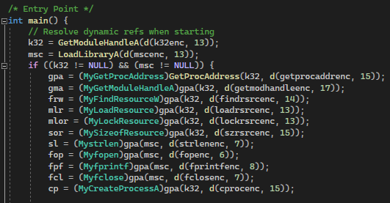
Attack v1 Visualization
Changed handle to kernel32.dll from LoadLIbraryA to GetModuleHandleA
Loaded dynamic APIs for:
GetProcAddress
Strlen

Slide 17
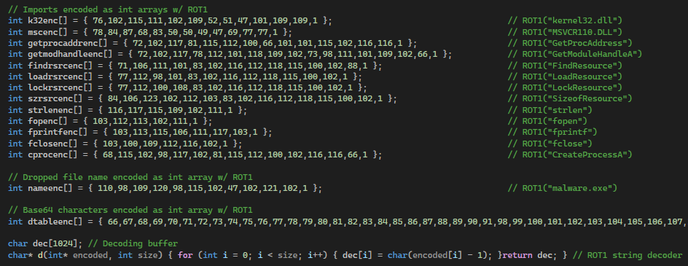
Attack v1 Visualization
Encoded all strings with ROT1
Added encoded strings for:
Base64 decoding table
GetProcAddress
Strlen

Slide 18
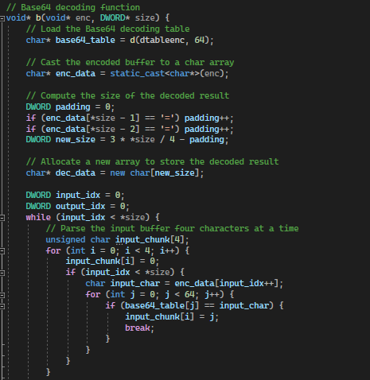
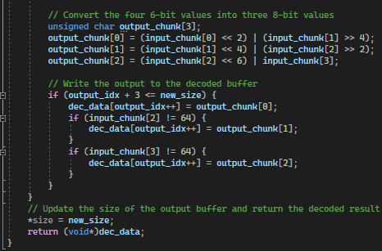
Attack v1 Visualization
Implemented manual Base64 decoder

Slide 19
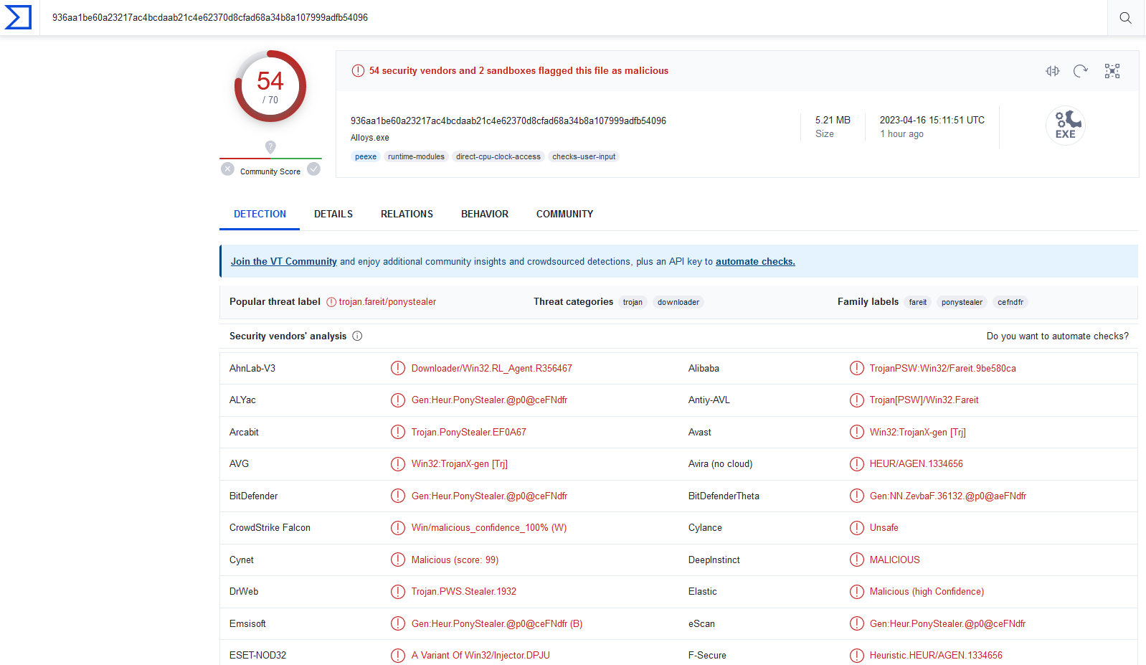
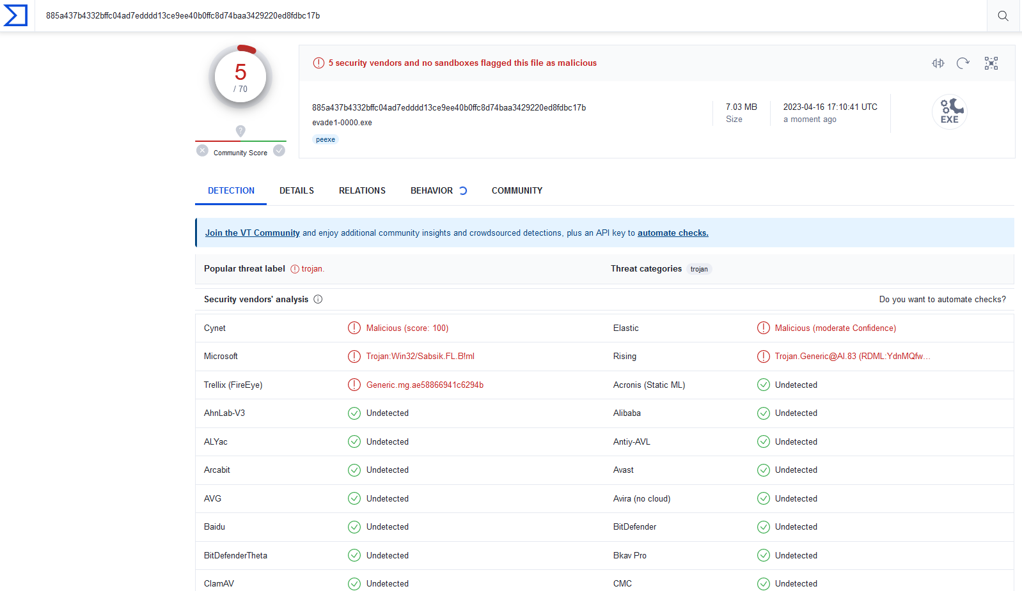
Attack v1 Results
VirusTotal of Evade1-0000 before and after
Before
After

Slide 20
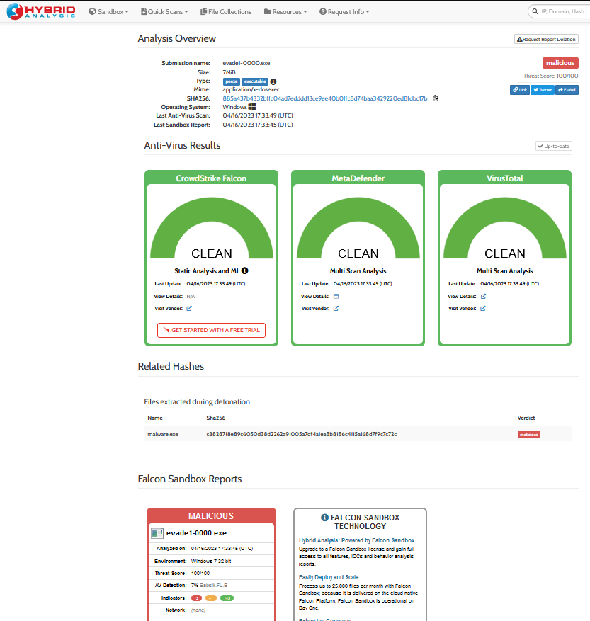
Attack v1 Results
Hybrid Analysis

Slide 21
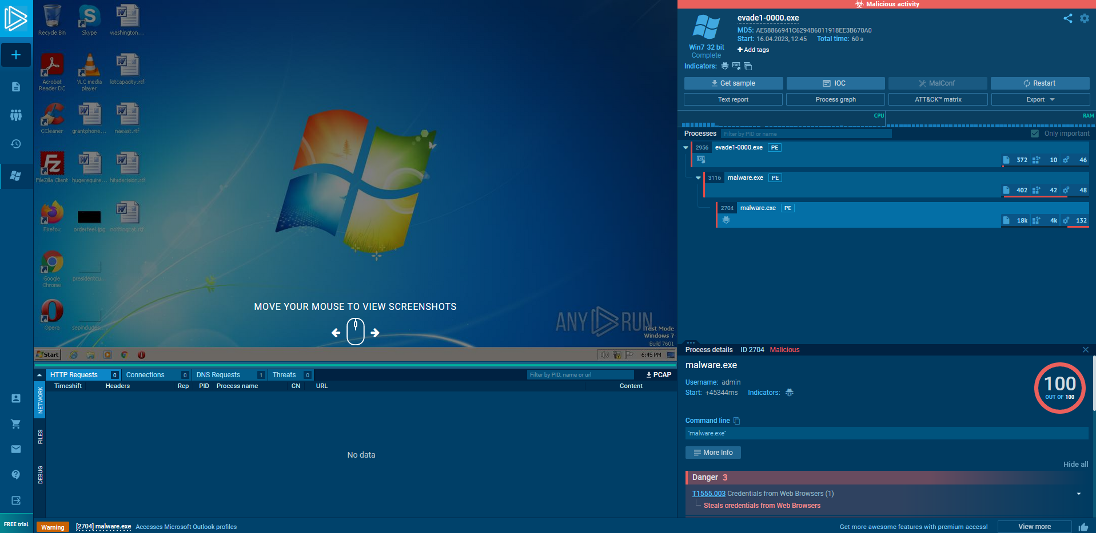
Attack v1 Results
Sandbox Execution

Slide 22
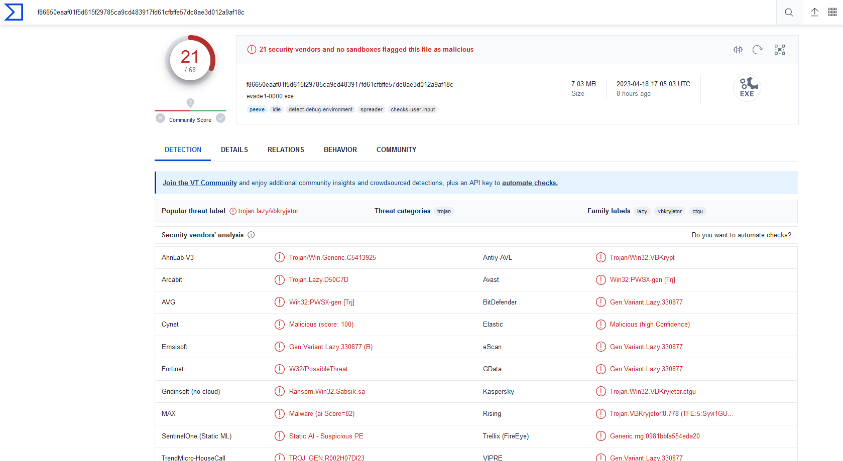
Attack v1 Additional Note
Changing nothing and running Evade1-0000 24 hours later
Indicates industry information sharing and quick retrain

Slide 23
Attack v2 Summary
A list of improvements added:
Manually parsed Kernel32.dll to find GetProcAddress
Added dynamic reference for LoadLibraryA
Implemented manual computation of int array length
Implemented manual conversion of GETINTRESOURCE
Added error checking at each stage of dynamic loading

Slide 24
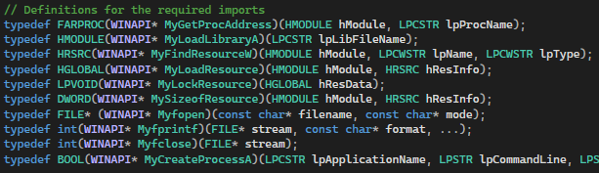
Attack v2 Visualization
Replaced dynamic API for GetModuleHandleA with LoadLibraryA
Removed dynamic API strlen

Slide 25
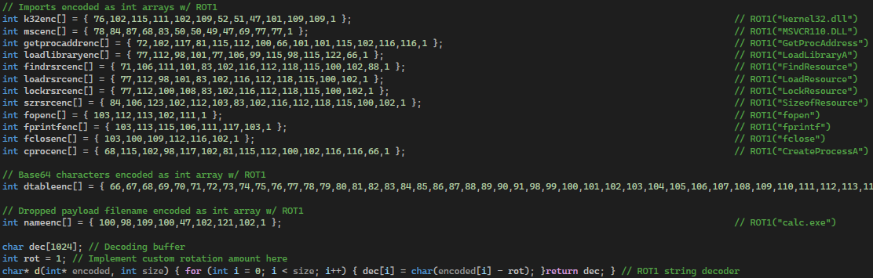
Attack v2 Visualization
Replaced encoded string for GetModuleHandleA with LoadLibraryA
Removed encoded string for strlen

Slide 26
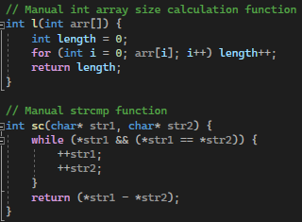
Attack v2 Visualization
Implemented manual int array size calculation
Implemented manual strcmp

Slide 27
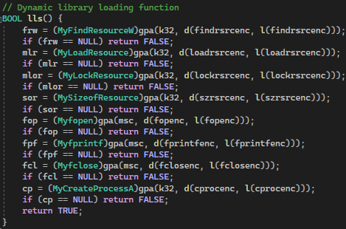
Attack v2 Visualization
Removed dynamic loading for GetModuleHandleA and strlen
Moved dynamic loading into encapsulated function

Slide 28
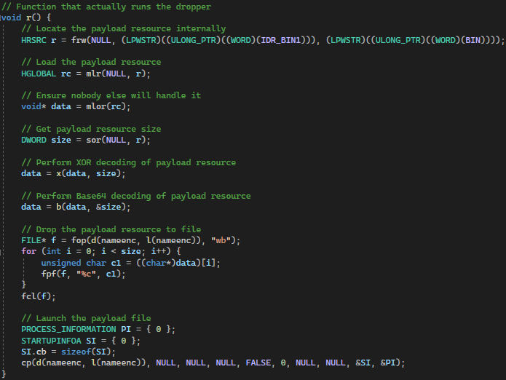
Attack v2 Visualization
Moved actual dropper into encapsulated function

Slide 29
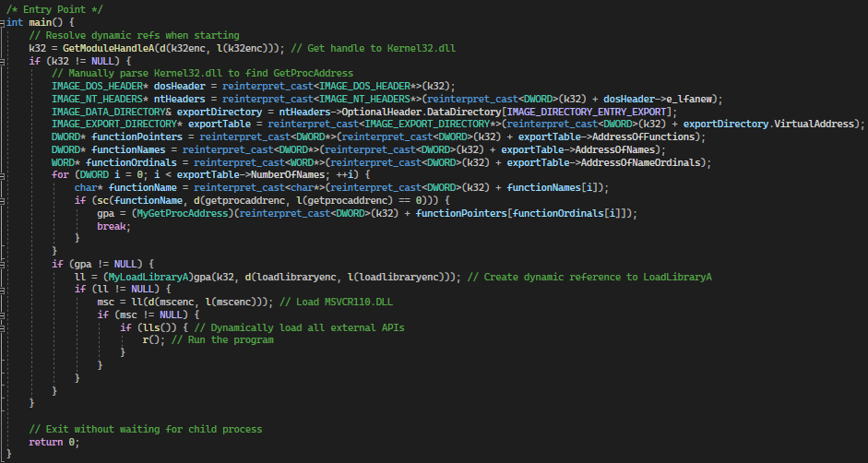
Attack v2 Visualization
Simplified main by calling encapsulated functions
Replaced handle to ke32 with LoadLibraryA
Manually parsed k32 to find base address for GetProcAddress

Slide 30
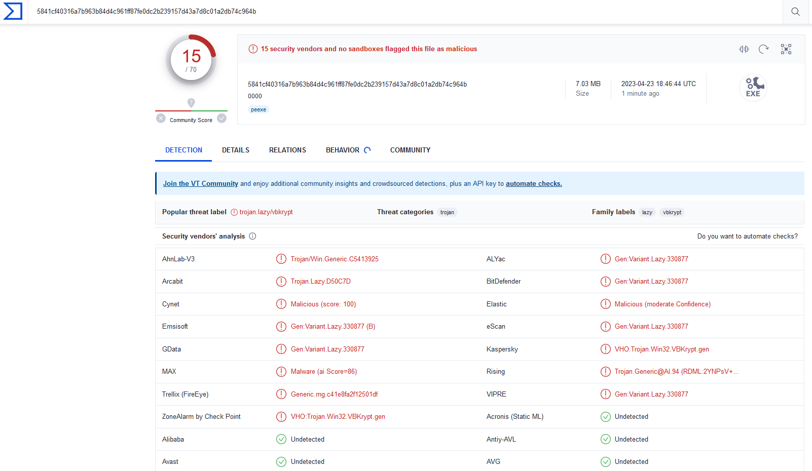
Attack v2 Results
VirusTotal of Evade1-0000 (dropped from 21 to 15)

Slide 31
Attack v3 Summary
While waiting for results from round 1, attempt to bypass remaining VT antiviruses using dynamic analysis evasion
A list of improvements added:
Added 60 second wait timer before execution
Added sandbox environment detection
Added debugger detection

Slide 32
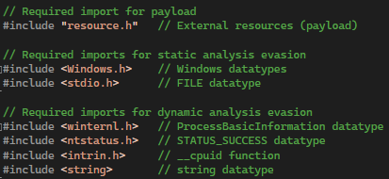
Attack v3 Visualization
Added new static imports for dynamic analysis evasion

Slide 33
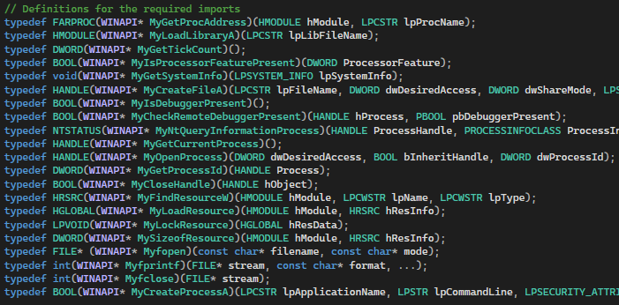
Attack v3 Visualization
Added additional dynamic imports for dynamic analysis evasion:
GetTickCount
IsProcessorFeaturePresent
GetSystemInfo
CreateFileA
IsDebuggerPresent
CheckRemoteDebuggerPresent
NtQueryInformationrocess
GetCurrentProcess
OpenProcess
GetProcessId
CloseHandle

Slide 34
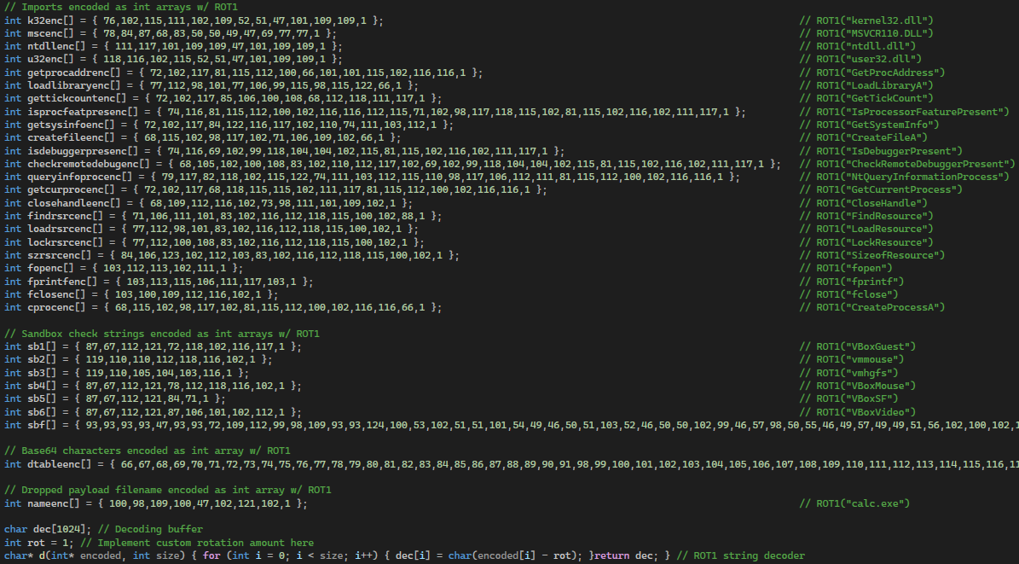
Attack v3 Visualization
Added additional encoded API strings for dynamic analysis evasion:
GetTickCount
IsProcessorFeaturePresent
GetSystemInfo
CreateFileA
IsDebuggerPresent
CheckRemoteDebuggerPresent
NtQueryInformationrocess
GetCurrentProcess
OpenProcess
GetProcessId
CloseHandle
Virtual machine drivers
VBoxGuest
Vmmouse
Vmhgfs
VBoxMouse
VBoxSF
VBoxVideo

Slide 35
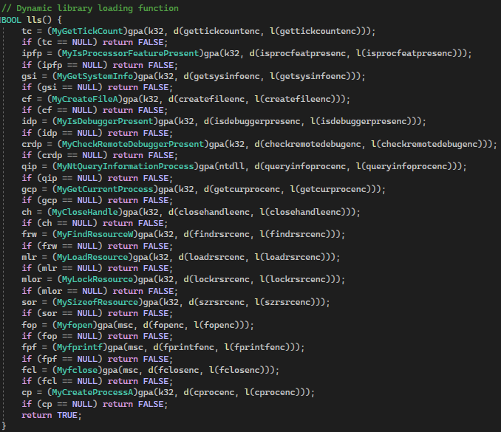
Attack v3 Visualization
Loading of new dynamic APIs for dynamic analysis evasion

Slide 36
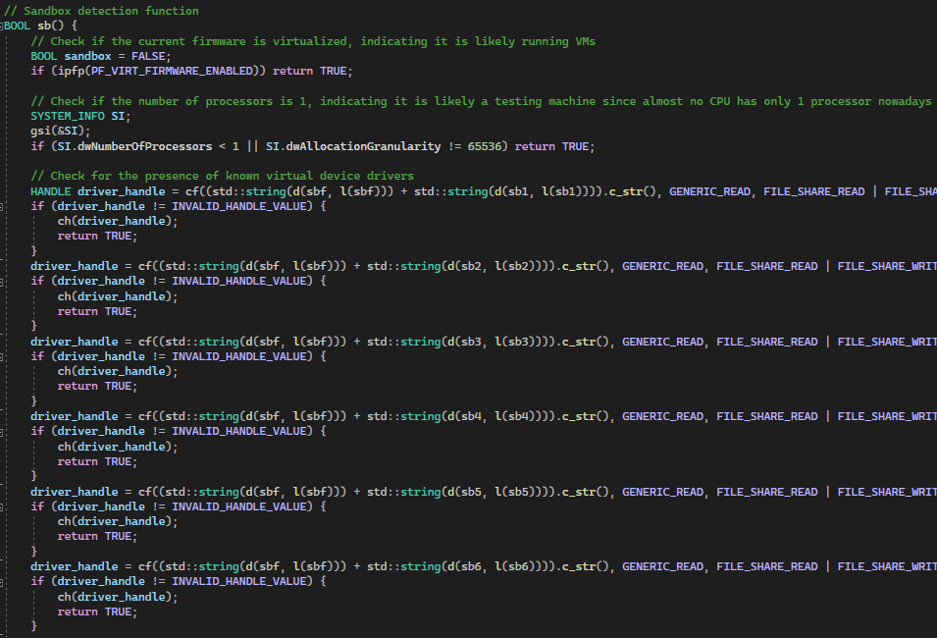
Attack v3 Visualization
Sandbox environment detection for dynamic analysis evasion (Ch1-3)
Check 1
If virtualization enabled
Check 2
If processor count == 1
Check 3
If any common VM driver present

Slide 37
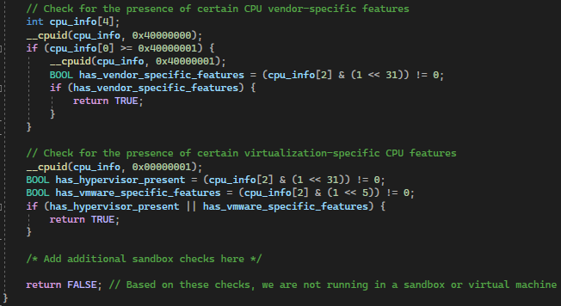
Attack v3 Visualization
Sandbox environment detection for dynamic analysis evasion (Ch4-5)
Check 4
If vendor virtualization flags set in CPU
Check 5
If standard virtualization flags are set in CPU

Slide 38
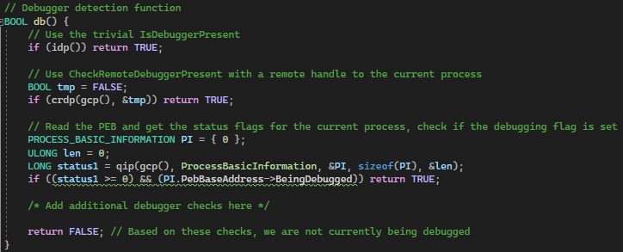
Attack v3 Visualization
Debugger detection for dynamic analysis evasion
Check 1
IsDebuggerPresent
Check 2
CheckRemoteDebuggerPresent w/ handle to current process
Check 3
Traverse PEB linked-list and fund process block for current process and check if debugger is currently attached

Slide 39
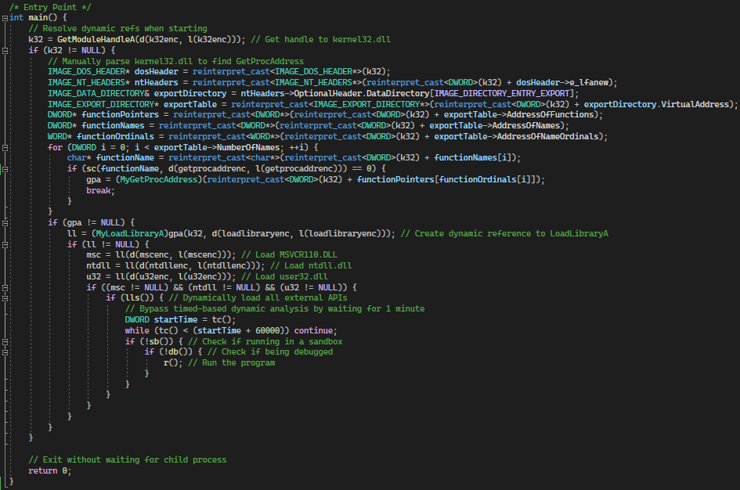
Attack v3 Visualization
Modified main to run 1 minute wait, sandbox detection, and debugger detection before running the dropper.

Slide 40
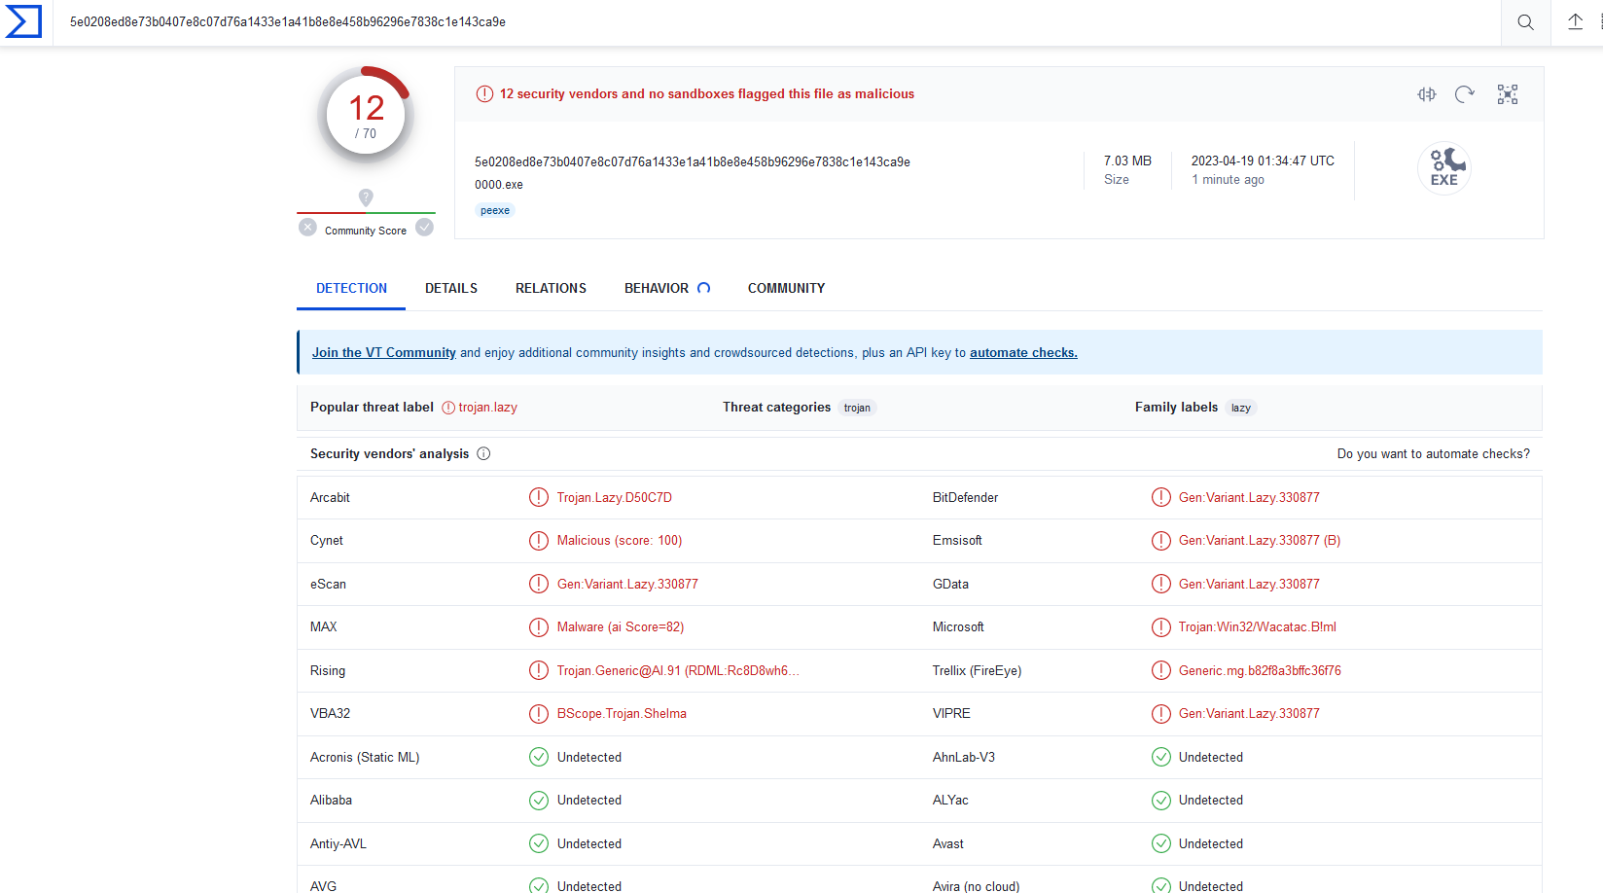
Attack v3 Results
VirusTotal of Evade1-0000 (dropped from 15 to 12)

Slide 41
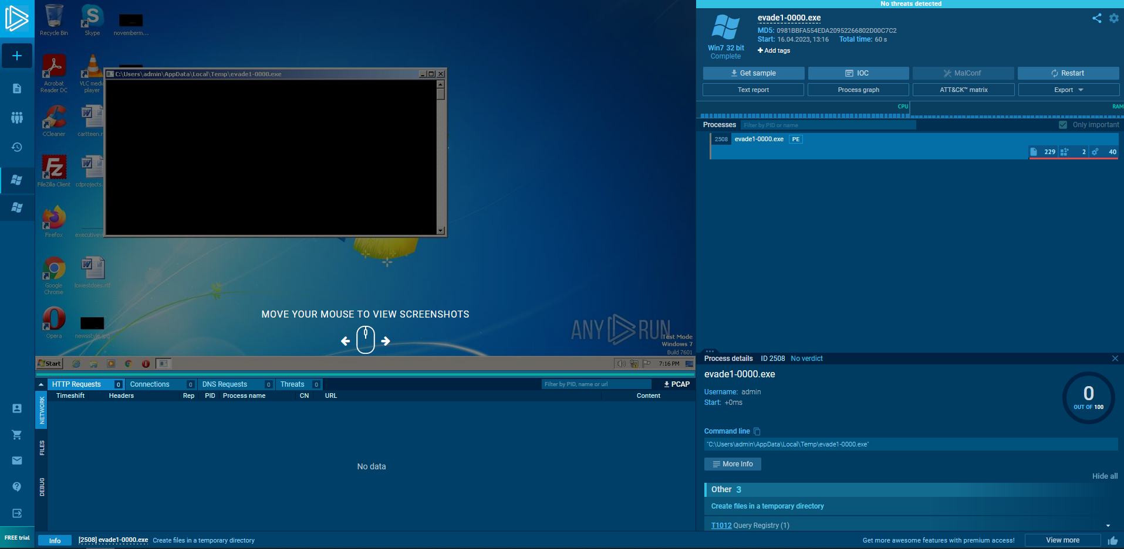
Attack v3 Results
Sandbox Execution (bypasses sandbox analysis)

Slide 42
Attack v4 Summary
After receiving results from round 1
Noticed that not a single sample evaded Yasir’s model
Found invalid PE handling in Yasir’s model
Exploited Yasir’s model to force a benign classification
A list of improvements added:
Created benign stager that runs after compilation and before execution

Slide 43
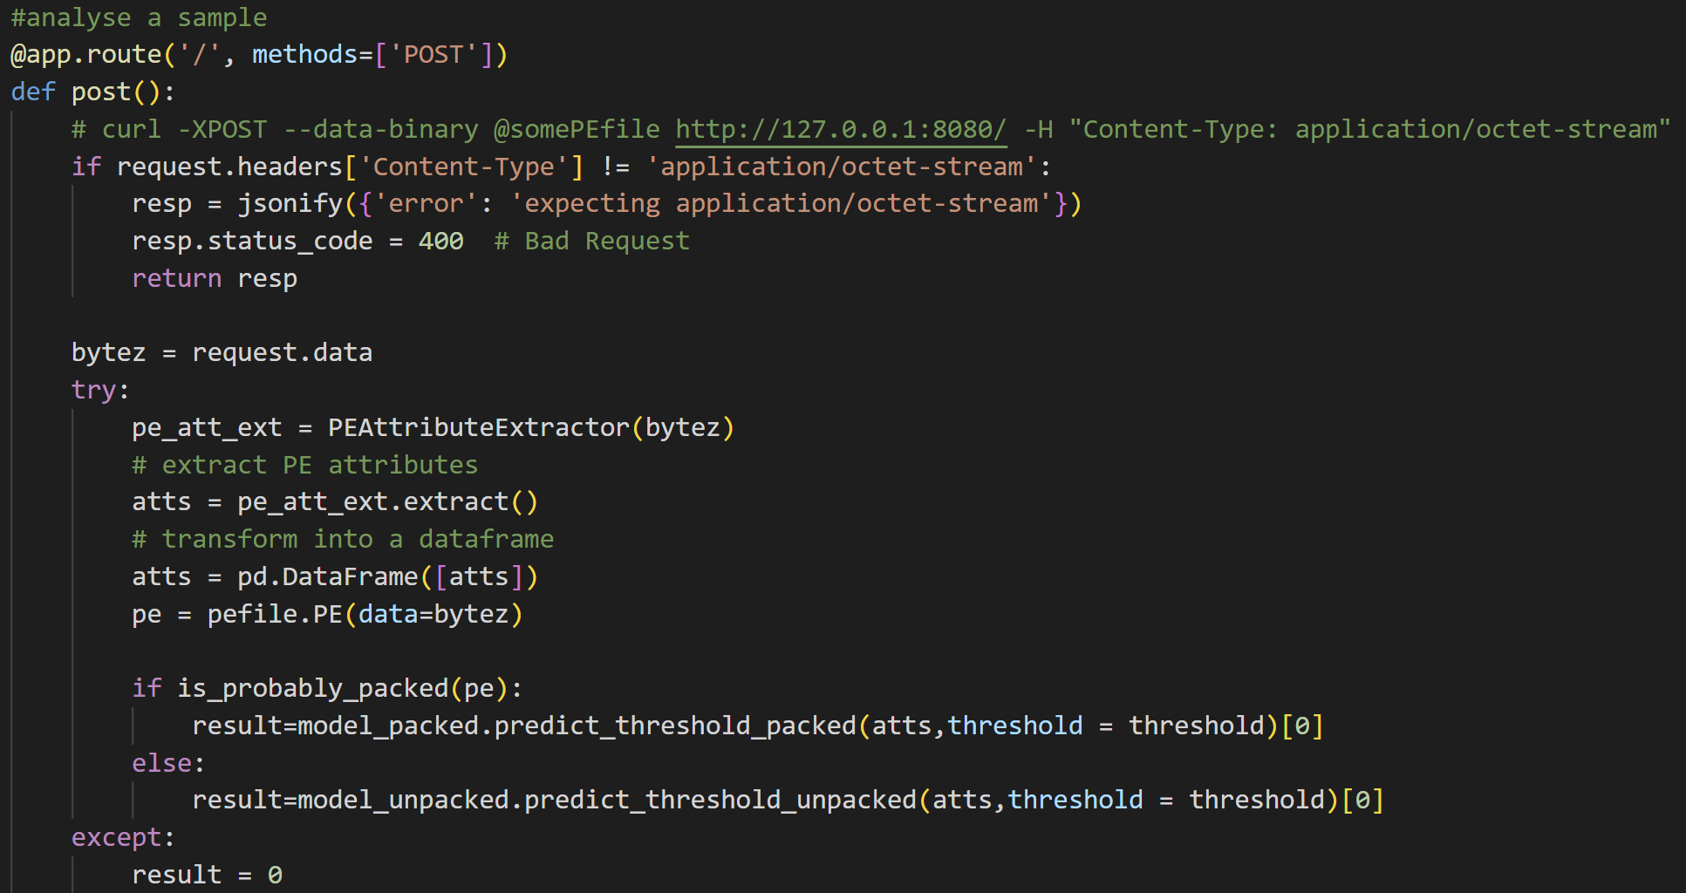
Attack v4 Visualization
Vulnerability in Yasir’s model (all errors return benign)

Slide 44
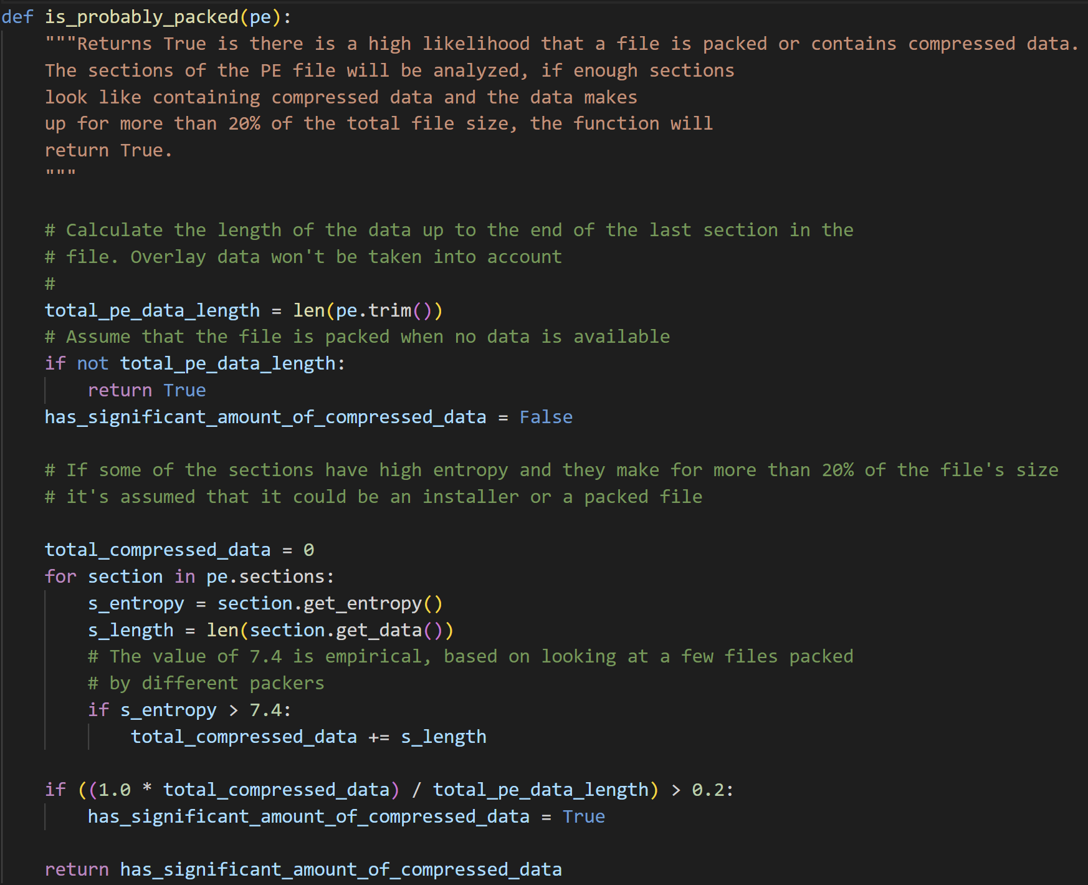
Attack v4 Visualization
Vulnerability in Yasir’s model (should use hasattr before accessing pe.sections)

Slide 45
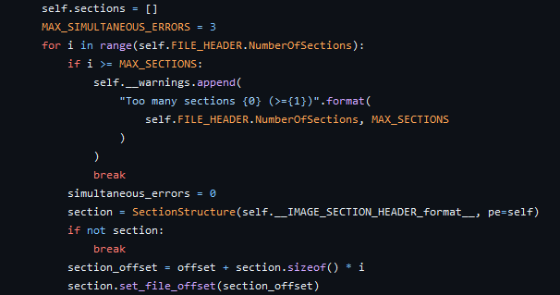
Attack v4 Visualization
How the Pefile module gathers sections when calling pe.sections
Directly uses NumberOfSections as count
Either set NumberOfSections to 0 or greater than MAX_SECTIONS

Slide 46
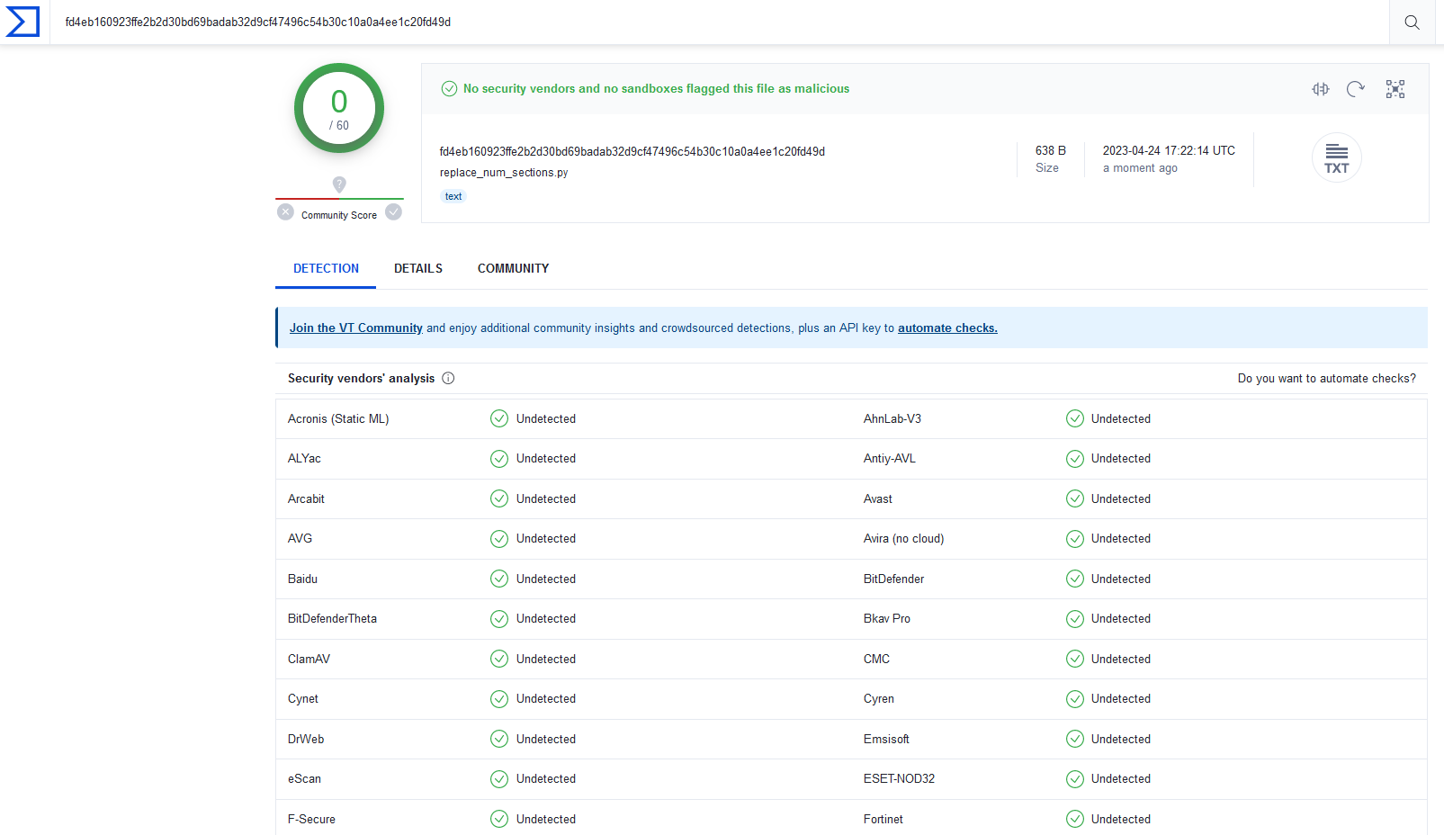
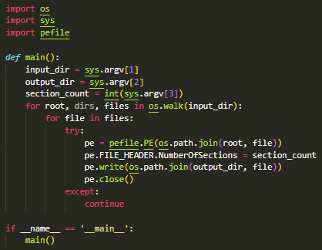
Attack v4 Visualization
Stager created to modify each executable NumberOfSections
Classified as benign

Slide 47
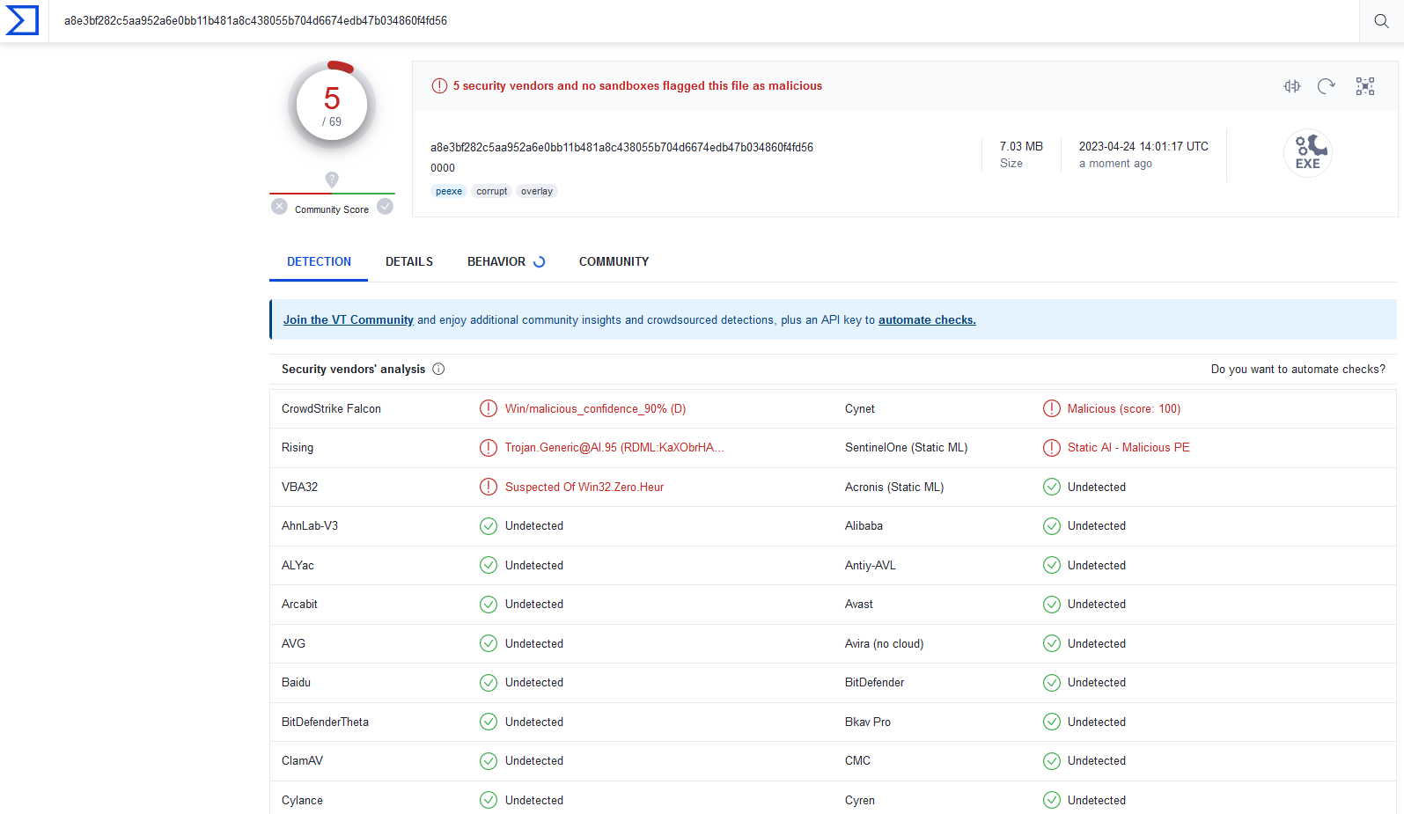
Attack v4 Results
VirusTotal of Evade1-0000 (drops from 12 to 5, overall 54 to 5)

Slide 48
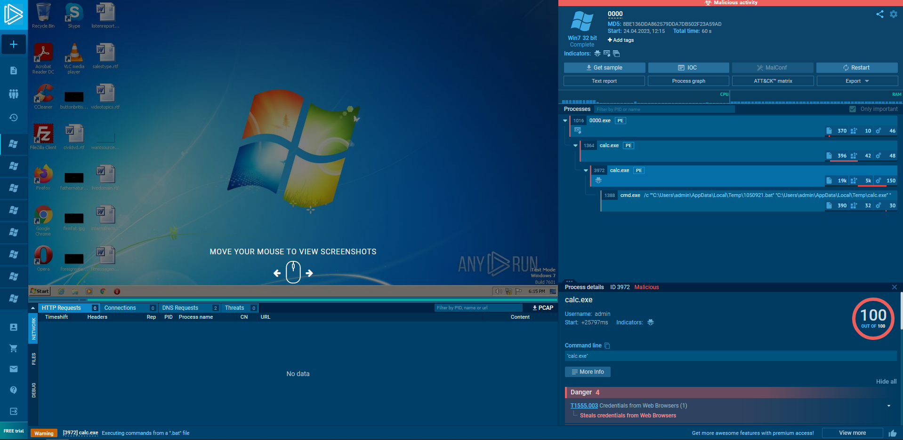
Attack v4 Results
Sandbox Execution (stager executed on sandbox machine before running dropper)

Slide 49
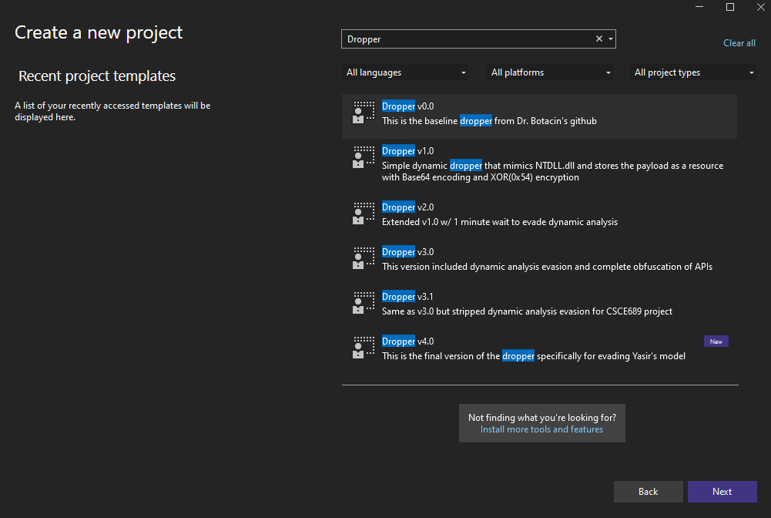
Additional Tools – VS Ease of Use
Create VS templates for quick project creation

Slide 50
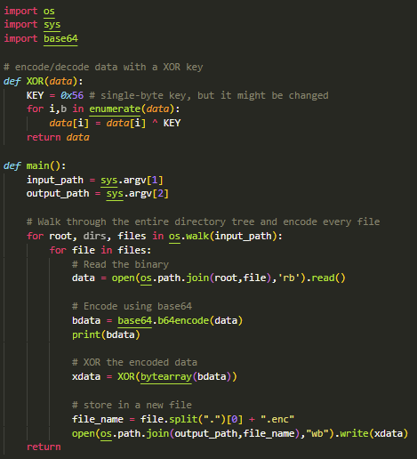
Additional Tools – Creating Encoded Resources
Program to perform XOR encryption and Base64 encoding of files

Slide 51
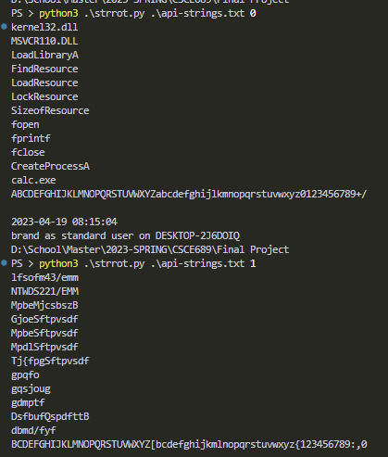
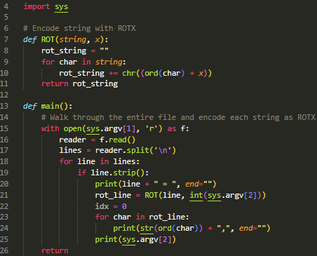
Additional Tools – Creating ROT1 int Arrays
Program to perform ROTX encoding of API strings

Slide 52
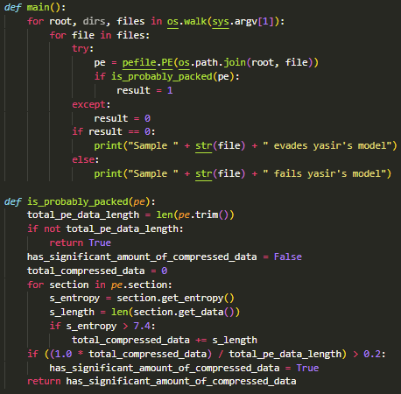
Additional Tools – Testing Yasir’s Vulnerability
Program to test if samples exploit Yasir’s model

Slide 53
Future Work
Embed dropper in different file type
Python executable (auto-py-to-exe) [1] [2]
Excell plugin (XLL) [1] [2]
Incorporate different method to launch process
Inject into own process then return execution after [1]
Doppelgӓng another legitimate process [1]
Add more sandbox and debugger detection methods
Wait to execute until after reboot [1]
Lock kernel32.dll to prevent analysis programs from using [2]
Self patch NumberOfSections to remove stager and still bypass is_packed test
Create program with 1 section of assembly instructions for updating NumberOfSections and BaseOfCode, then restart the executable

